Slide 1
CSMA (carrier sense multiple access)
CSMA: listen before transmit:
if channel sensed idle: transmit entire frame
if channel sensed busy, defer transmission
human analogy: don’t interrupt others!

Slide 2
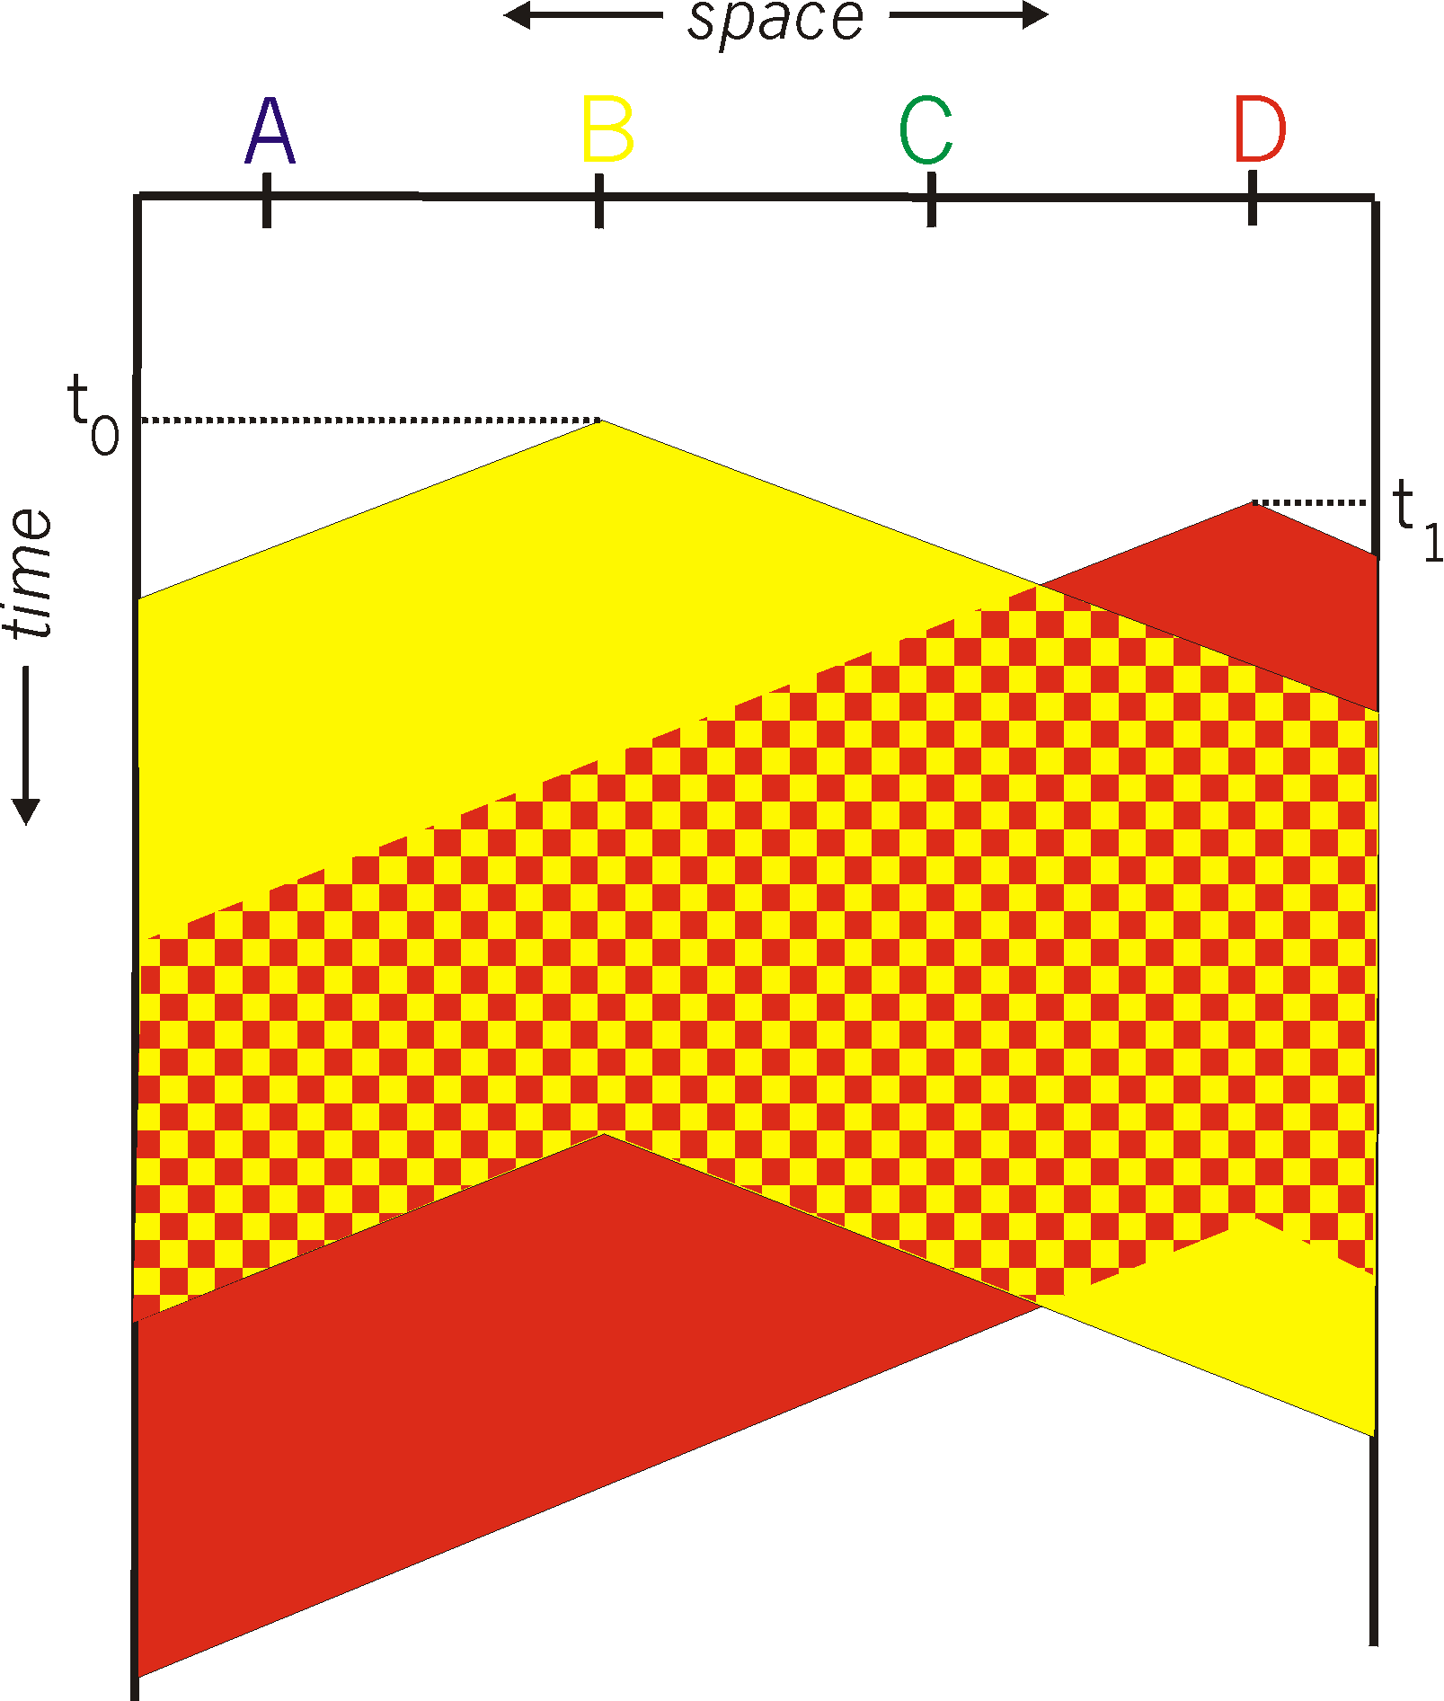

CSMA collisions
spatial layout of nodes
collisions can still occur: propagation delay means two nodes may not hear each other’s transmission
collision: entire packet transmission time wasted
distance & propagation delay play role in in determining collision probability

Slide 3
CSMA/CD (collision detection)
CSMA/CD: carrier sensing, deferral as in CSMA
collisions detected within short time
colliding transmissions aborted, reducing channel wastage
collision detection:
easy in wired LANs: measure signal strengths, compare transmitted, received signals
difficult in wireless LANs: received signal strength overwhelmed by local transmission strength
human analogy: the polite conversationalist

Slide 4
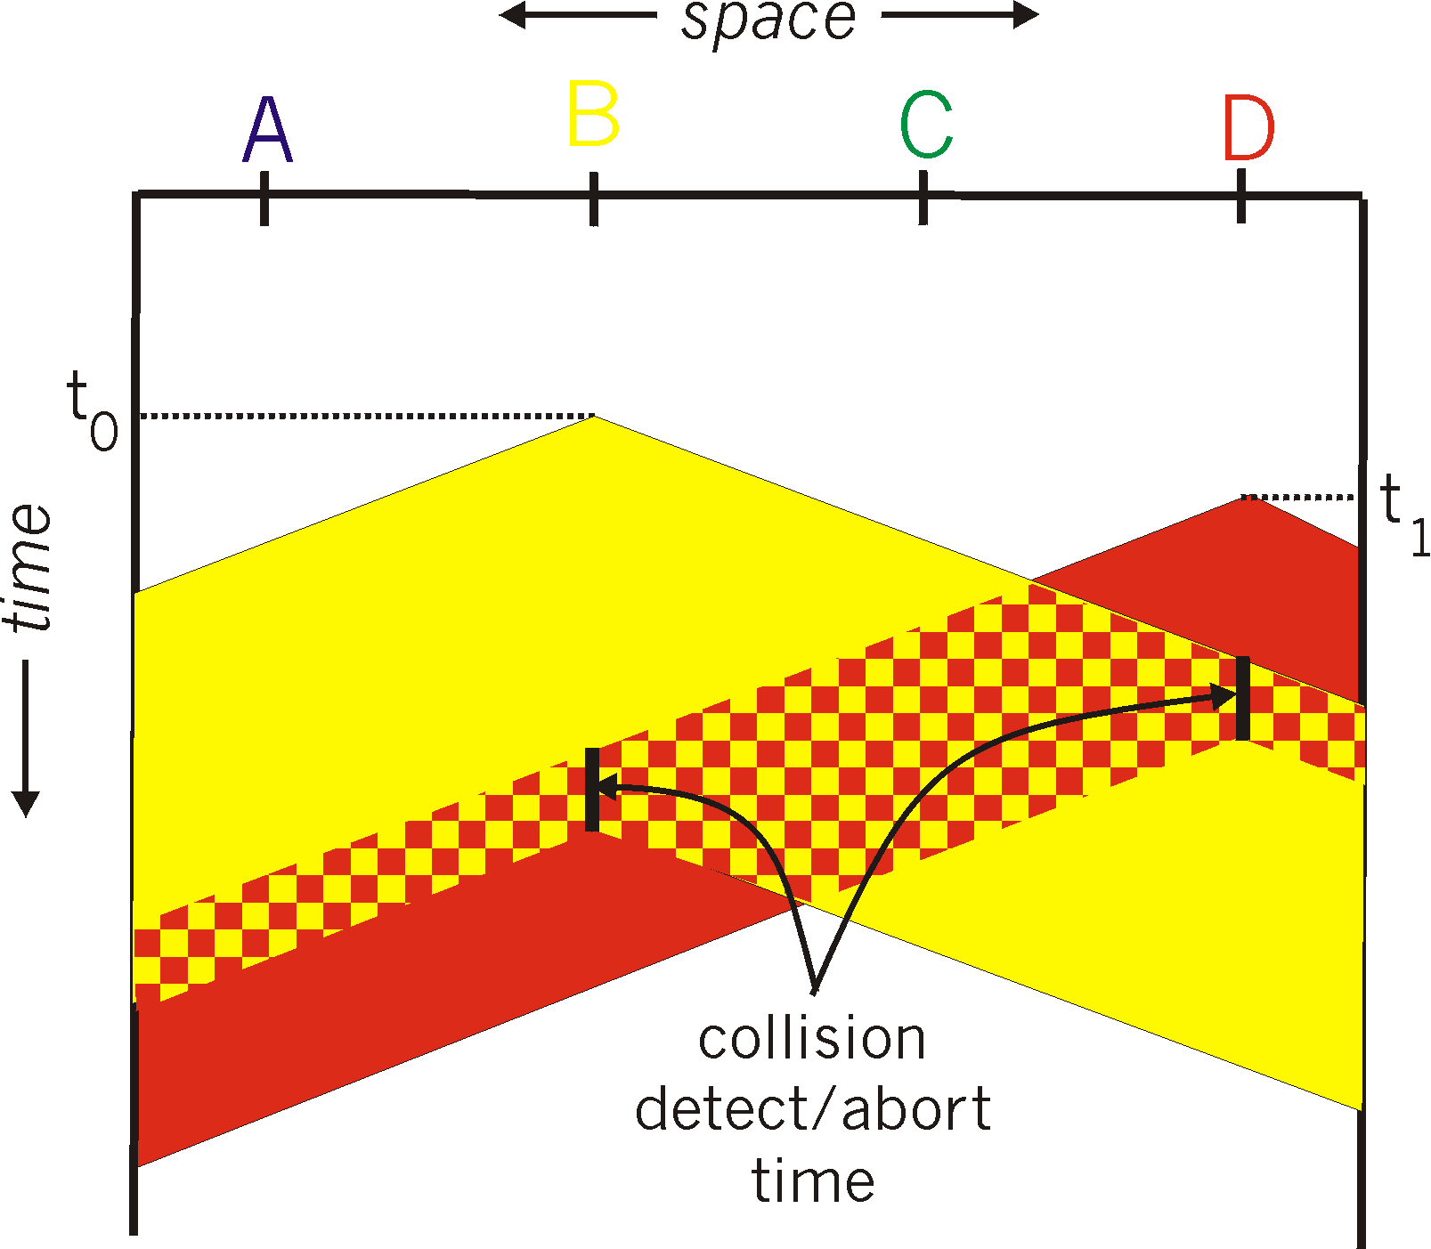
CSMA/CD (collision detection)
spatial layout of nodes

Slide 5
Ethernet CSMA/CD algorithm
1. NIC receives datagram from network layer, creates frame
2. If NIC senses channel idle, starts frame transmission. If NIC senses channel busy, waits until channel idle, then transmits.
3. If NIC transmits entire frame without detecting another transmission, NIC is done with frame !
4. If NIC detects another transmission while transmitting, aborts and sends jam signal
5. After aborting, NIC enters binary (exponential) backoff:
after mth collision, NIC chooses K at random from {0,1,2, …, 2^{m}-1}. NIC waits K·512 bit times, returns to Step 2
longer backoff interval with more collisions

